Slide 1

Exploratory Data Analysis
G2M insight for Cab Investment firm
21/06/2021

Slide 2

Agenda
Executive Summary
Problem Statement
Approach
EDA
EDA Summary
Recommendations

Slide 3
Executive Summary
The Objective:
Recommend a company for the investor to invest in.
The Procedure :
Analyse the companies' users, demand and its potential and find out which company would be a better investment

Slide 4
Problem Statement
XYZ is a private firm in US. Due to remarkable growth in the Cab Industry in last few years and multiple key players in the market, it is planning for an investment in Cab industry and as per their Go-to-Market(G2M) strategy they want to understand the market before taking final decision.
But with the two leading cab companies, which one should the investors pick?
The Yellow Cab or The Pink Cab?

Slide 5



Approach
To make sure we make the correct decision we need to analyse the data properly.
I started off by loading the CSV files provided into a Jupyter notebook and started merging the relevant files together to form a single master data frame to preform the analysis on. I have also added a calculated ‘Profit’ column by subtracting the Cost of Trip from the Price Charged and changed the data type for the Date of Travel. After checking for Null values, my data frame was in perfect condition to start the analysis.
The data analysis consisted of:
• Calculating the profits for both companies, the Yellow Cab and the Pink Cab, annually and monthly.
• Checking which company has more demand per city
• The cost of the trip per KM for each company
• How much percentage the users spend out of their income on the cabs for each company
• The gender of the users for each company
• The payment methods for the users for each company

Slide 6
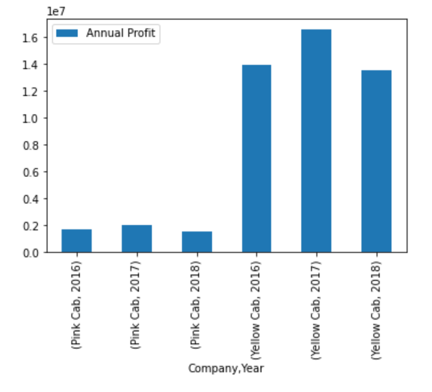
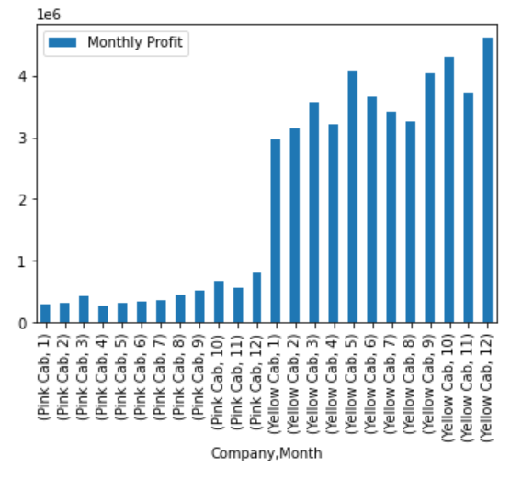
EDA - Profit
Annual Profit for both companies:
Monthly Profit for both companies:
We Can clearly see that the Yellow Cab is earning more profit than the Pink Cab

Slide 7
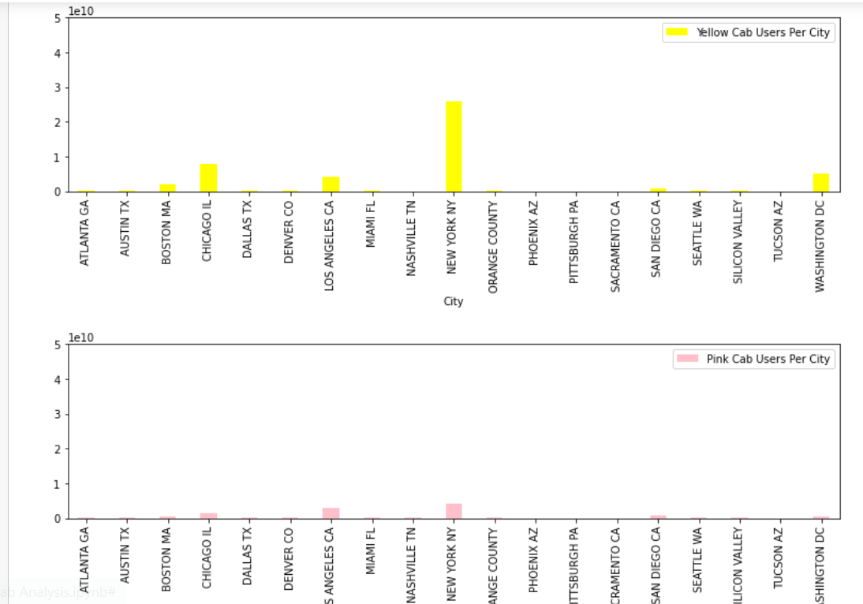
EDA - Demand
Demand Per City for both companies:
The Yellow Cab has more demand per city, Especially in cities such as New York and Chicago.

Slide 8
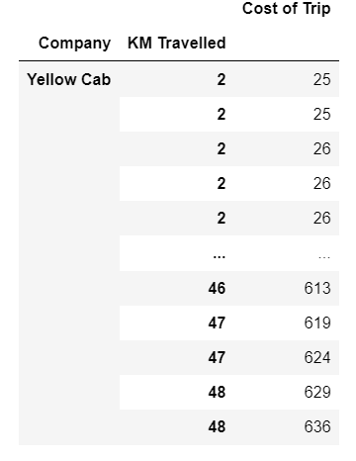
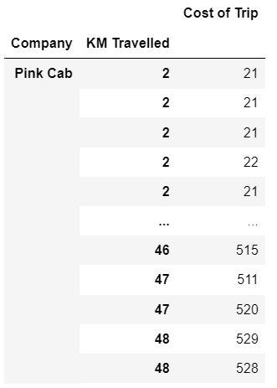
EDA – Cost of the Trip
The cost of the trip per KM for Yellow Cab:
The cost of the trip per KM for Pink Cab:
The data shows that the Pink Cab company costs less.

Slide 9
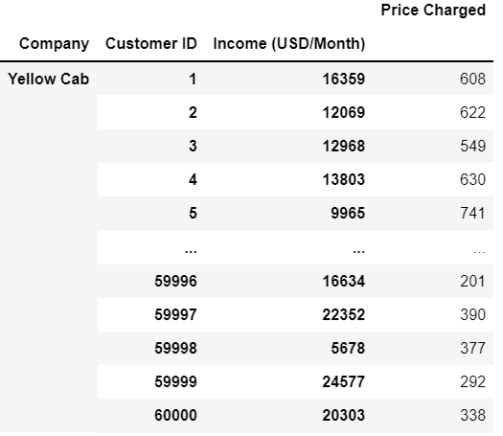
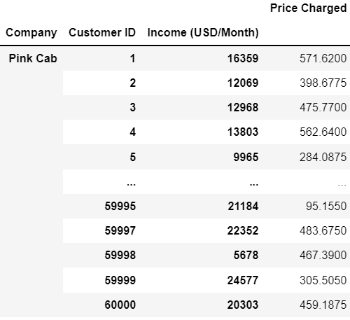
EDA – Money Spent
The percentage of money users spend on cabs out of their income

Slide 10
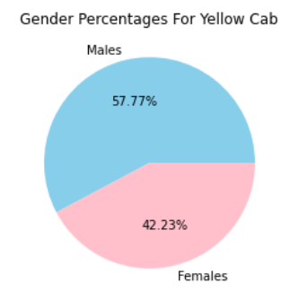
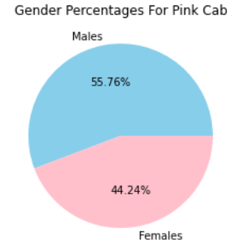
EDA - Genders
The percentage of each gender for Yellow Cab:
The percentage of each gender for Pink Cab:
According to the data, more women use the Pink Cab

Slide 11
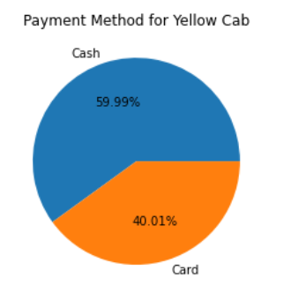
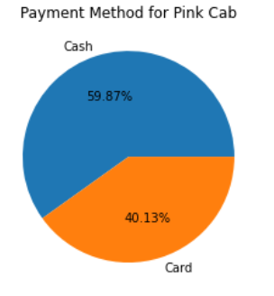
EDA – Payment Methods
The Payment Methods for Yellow Cab:
The Payment Methods for Pink Cab:
According to the data, the most used payment method is Cash for both companies

Slide 12
EDA Summary
1. The Yellow Cab profited approximately 8 times more than the Pink Cab from 2016-2018, with a noticeable increase during the holidays
2. Yellow Cab dominates more cities than the Pink Cab. However, Pink Cab is cheaper for the user
3. The Yellow Cab is earning more profit than the Pink Cab in cities such as New York and Los Angeles
4. Women are more likely to be the customers of the Pink Cab.
5. The majority of users preferred to use card as a payment method in both companies

Slide 13
Recommendations
Due to the strong evidence and data, we highly recommend the Yellow Cab company to invest in.

Slide 14
Thank You

